Slide 1

Enhanced Entity-Relationship Modeling
TIF 2302

Slide 2
Objectives
Limitations of basic concepts of the ER model and requirements to represent more complex applications using additional data modeling concepts.
Most useful additional data modeling concept of Enhanced ER (EER) model is called specialization/generalization.
A diagrammatic technique for displaying specialization/generalization in an EER diagram using UML.

Slide 3
Enhanced Entity-Relationship Model
Since 1980s there has been an increase in emergence of new database applications with more demanding requirements.
Basic concepts of ER modeling are not sufficient to represent requirements of newer, more complex applications.
Response is development of additional ‘semantic’ modeling concepts.

Slide 4
The Enhanced Entity-Relationship Model
Semantic concepts are incorporated into the original ER model and called the Enhanced Entity-Relationship (EER) model.
Examples of additional concept of EER model is called specialization / generalization.

Slide 5
Specialization / Generalization
Superclass
An entity type that includes one or more distinct subgroupings of its occurrences.
Subclass
A distinct subgrouping of occurrences of an entity type.

Slide 6
Specialization / Generalization
Superclass/subclass relationship is one-to-one (1:1).
Superclass may contain overlapping or distinct subclasses.
Not all members of a superclass need be a member of a subclass.

Slide 7
Specialization / Generalization
Attribute Inheritance
An entity in a subclass represents same ‘real world’ object as in superclass, and may possess subclass-specific attributes, as well as those associated with the superclass.

Slide 8
Specialization / Generalization
Specialization
Process of maximizing differences between members of an entity by identifying their distinguishing characteristics.
Generalization
Process of minimizing differences between entities by identifying their common characteristics.

Slide 9
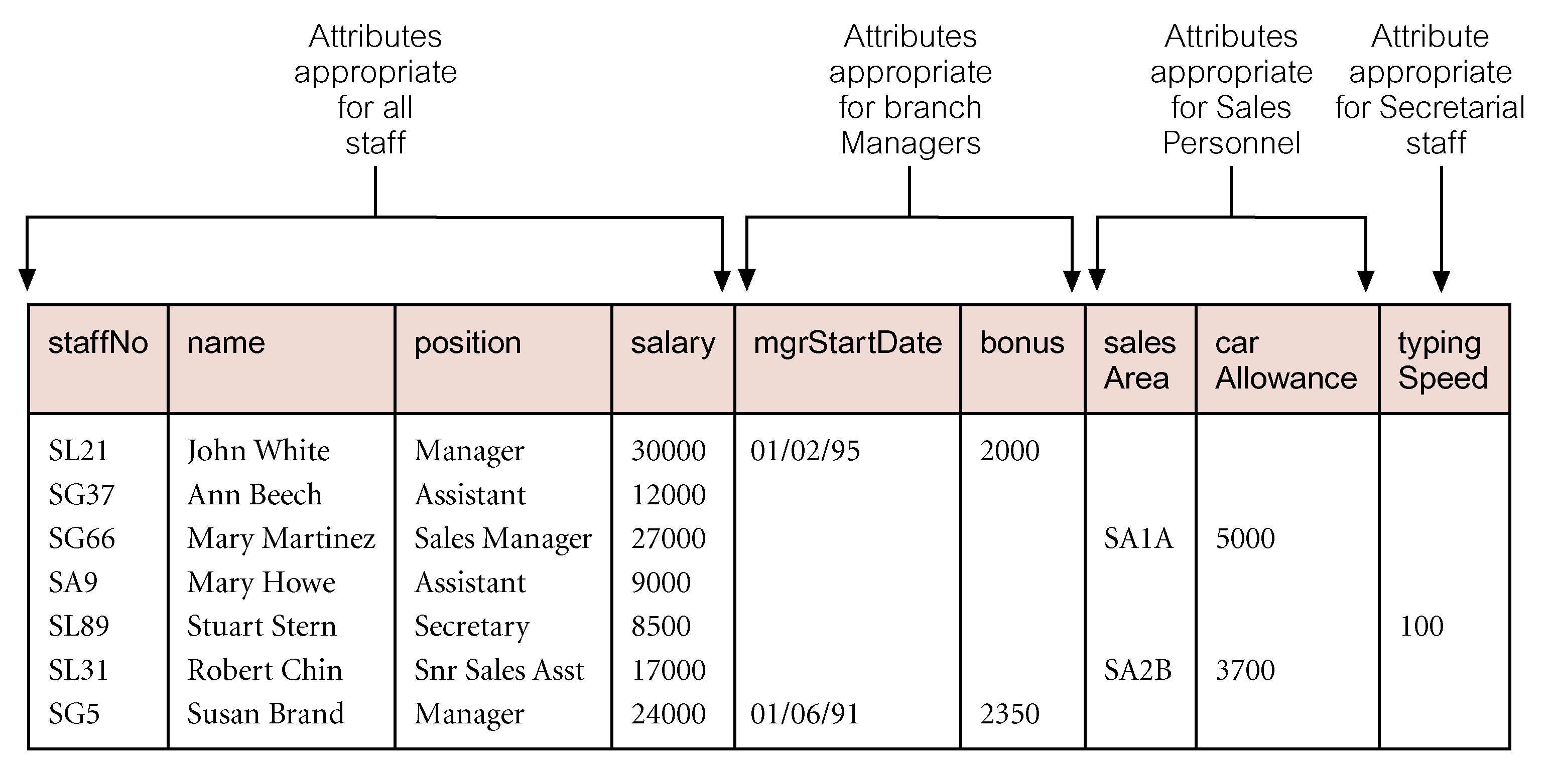
AllStaff relation holding details of all staff

Slide 10
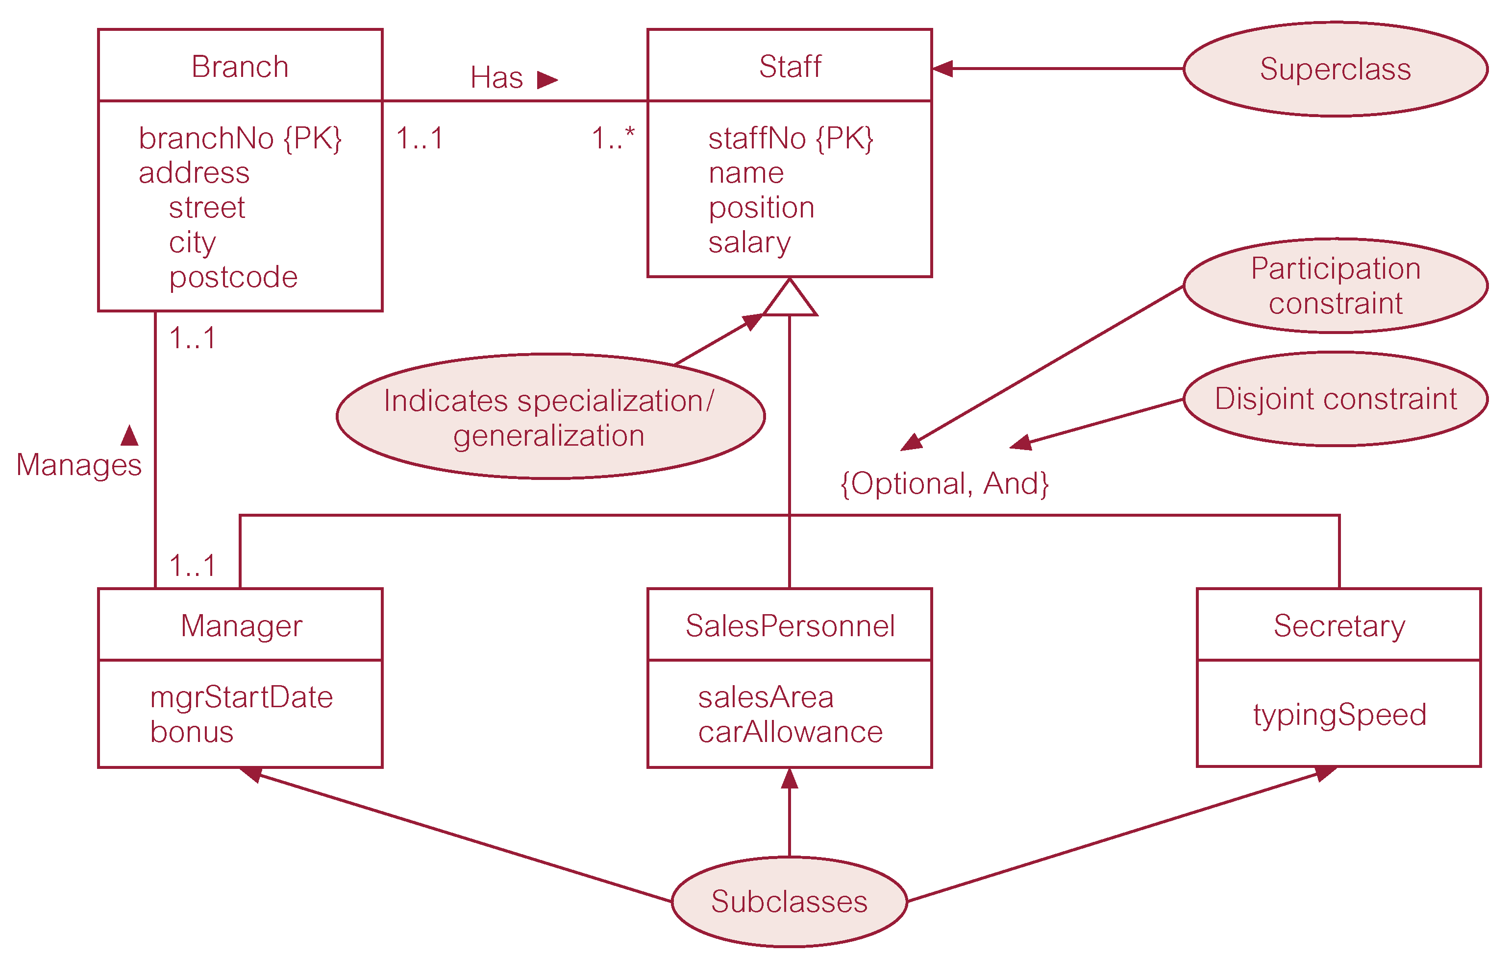
Specialization/generalization of Staff entity into subclasses representing job roles

Slide 11
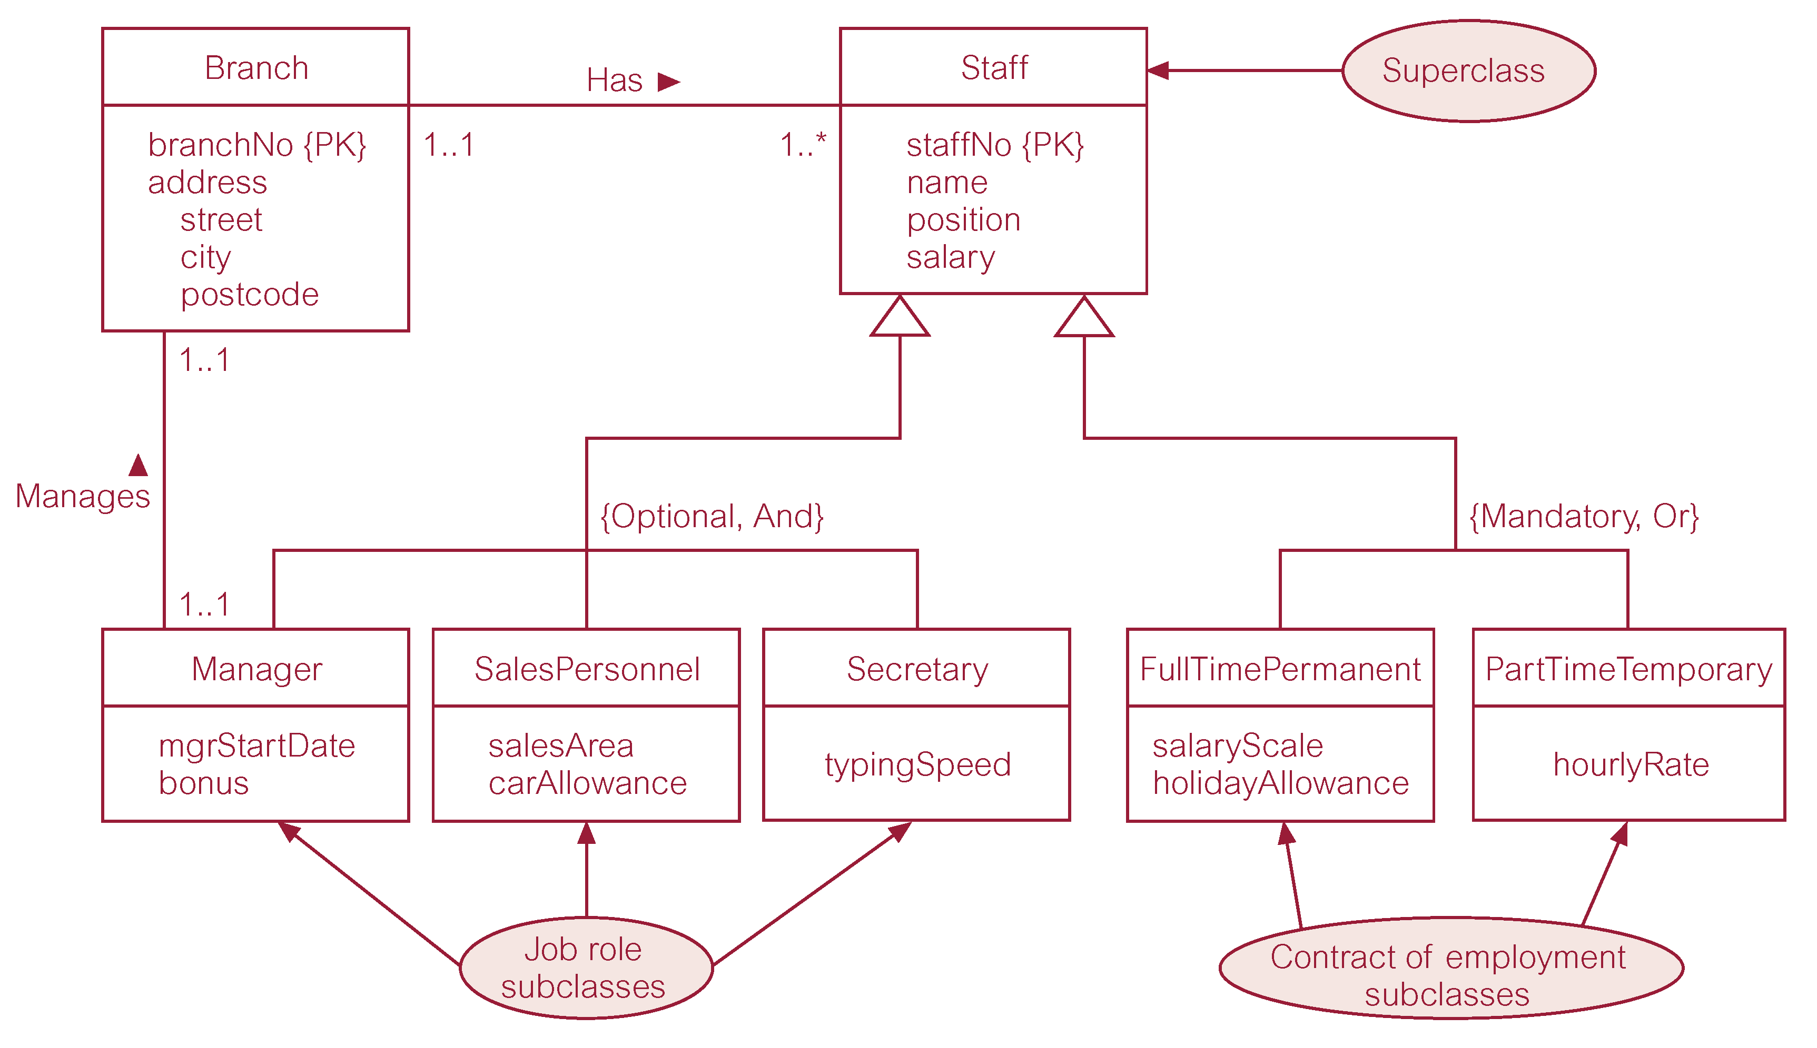
Specialization/generalization of Staff entity into job roles and contracts of employment

Slide 12
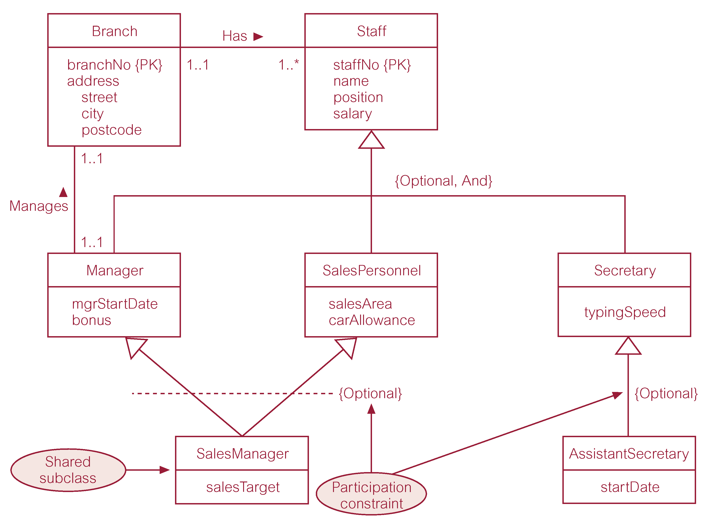
EER diagram with shared subclass and subclass with its own subclass

Slide 13
Constraints on Specialization / Generalization
Two constraints that may apply to a specialization/generalization:
participation constraints
disjoint constraints.
Participation constraint
Determines whether every member in superclass must participate as a member of a subclass.
May be mandatory or optional.

Slide 14
Constraints on Specialization / Generalization
Disjoint constraint
Describes relationship between members of the subclasses and indicates whether member of a superclass can be a member of one, or more than one, subclass.
May be disjoint or nondisjoint.

Slide 15
Constraints on Specialization / Generalization
There are four categories of constraints of specialization and generalization:
mandatory and disjoint
optional and disjoint
mandatory and nondisjoint
optional and nondisjoint.

Slide 16
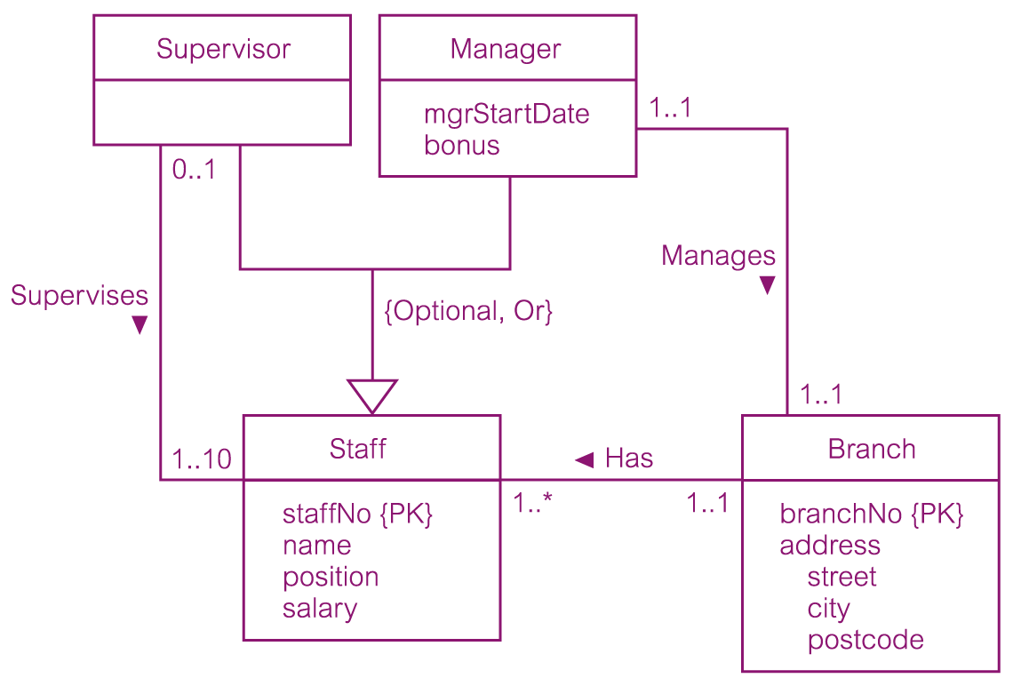
DreamHome worked example - Staff Superclass with Supervisor and Manager subclasses

Slide 17
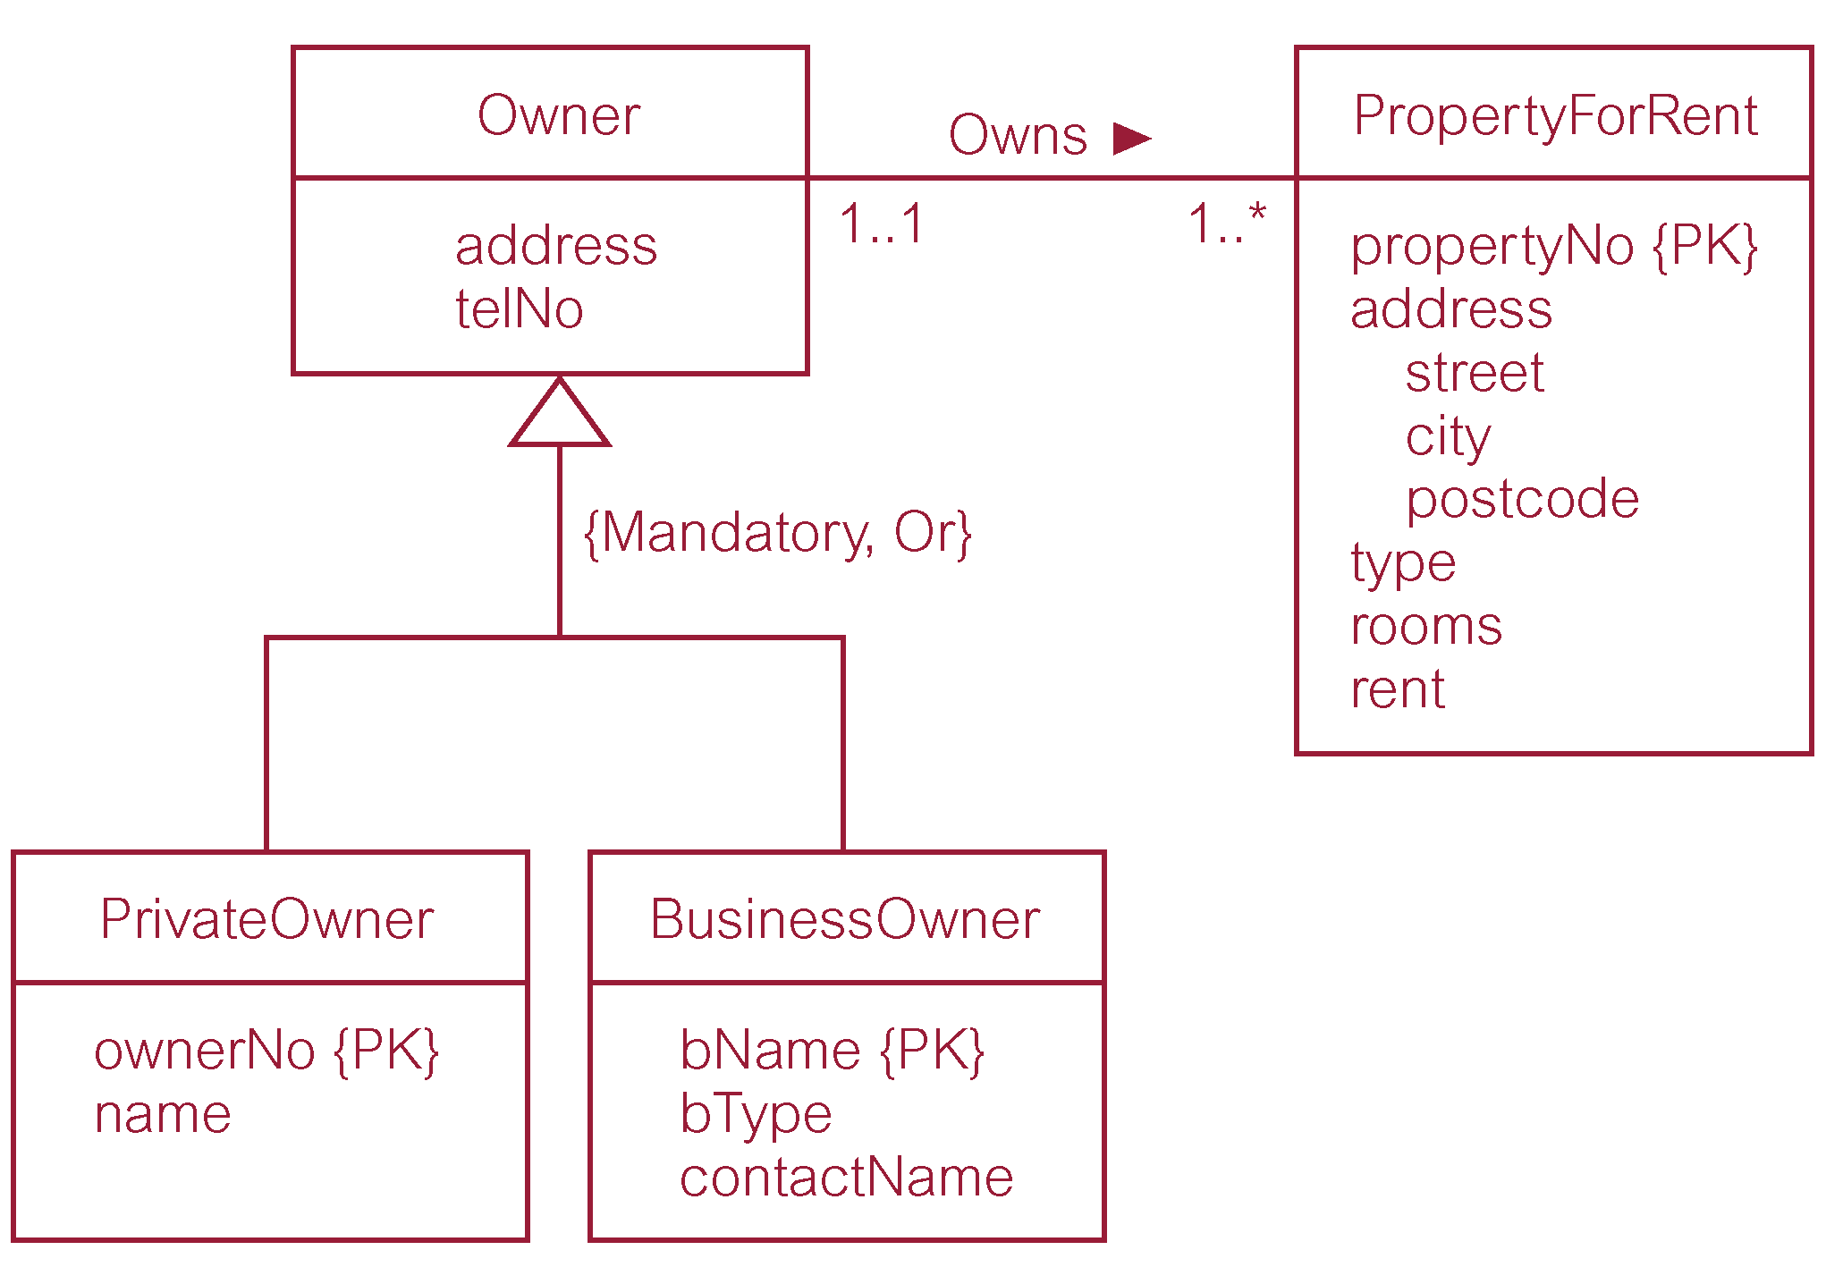
DreamHome worked example - Owner Superclass with PrivateOwner and BusinessOwner subclasses

Slide 18
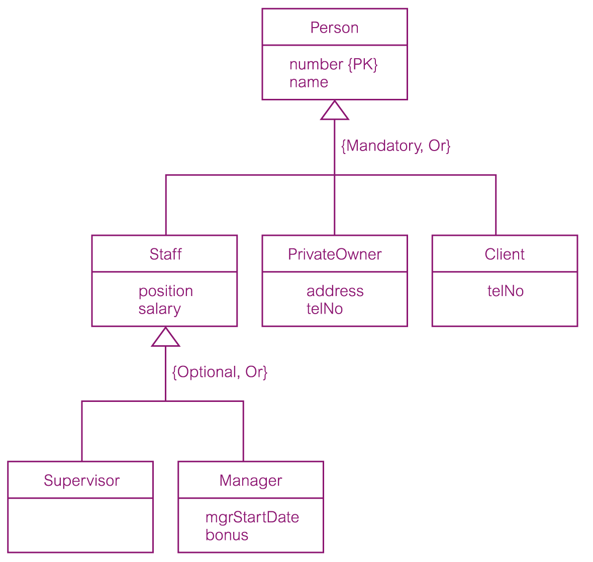
DreamHome worked example - Person superclass with Staff, PrivateOwner, and Client subclasses

